Slide 1

UDP - Sockets
Dr. S.F.Rodd
Professor, Dept. of CSE, GIT

Slide 2
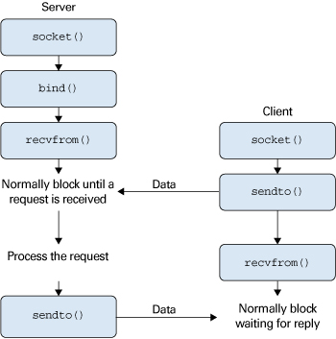
Sendto and Recivefrom function used in UDP

Slide 3
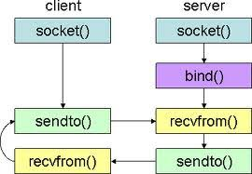
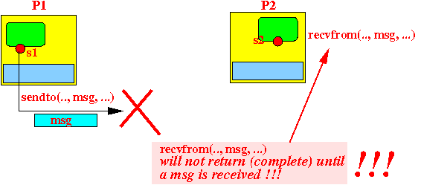
Sendto and Recivefrom function used in UDP

Slide 4
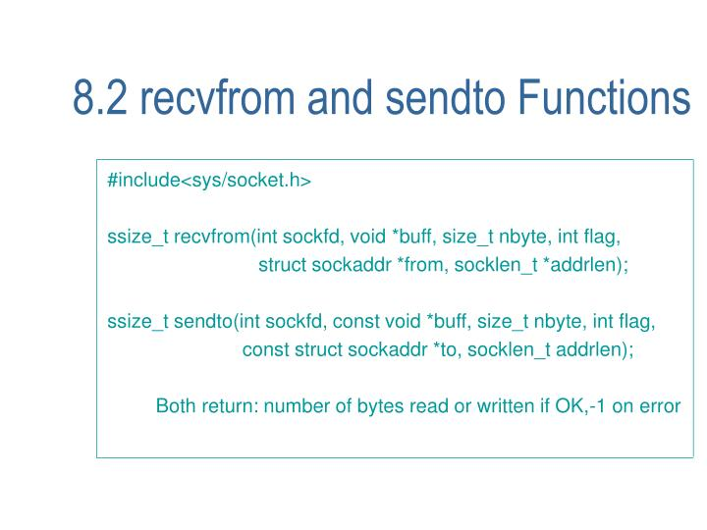
Sendto and Recivefrom function used in UDP

Slide 5
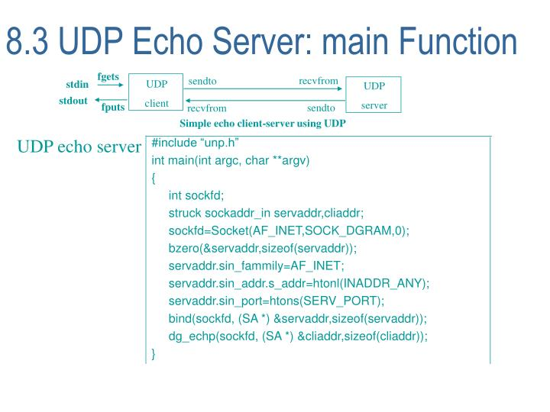
UDP Echo… Server, Client main

Slide 6
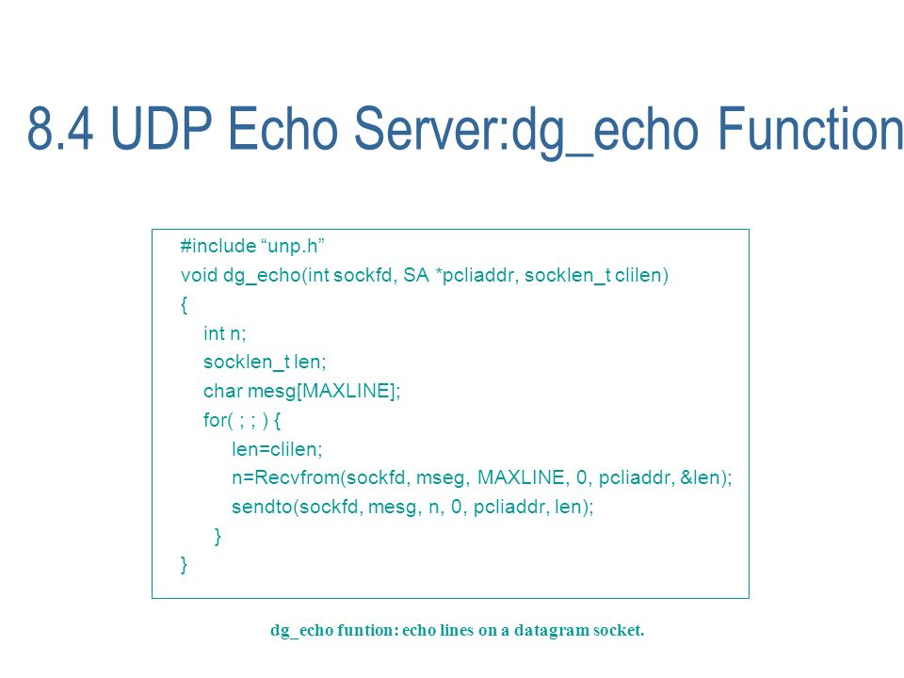
UDP Echo Server

Slide 7
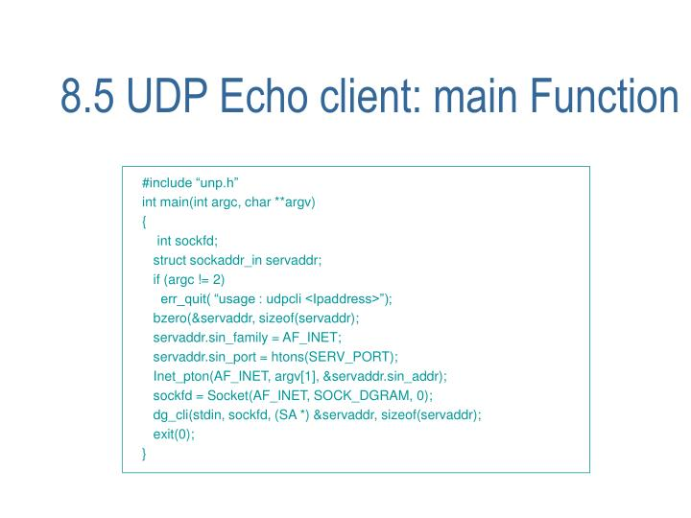
UDP Echo… Client main

Slide 8
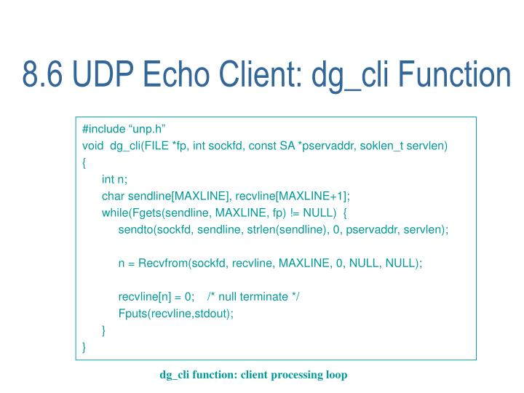
UDP Echo… dg_Cli

Slide 9
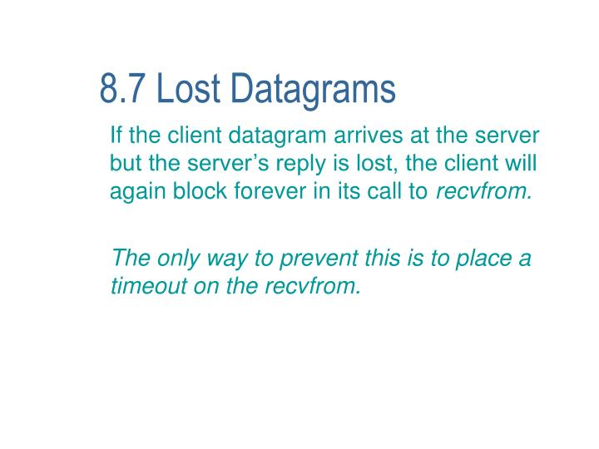
Lost - Datagrams

Slide 10
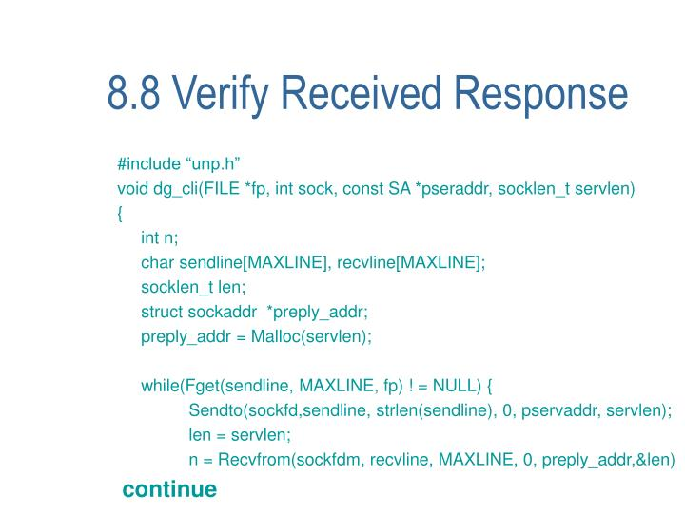
Verifying received responses

Slide 11
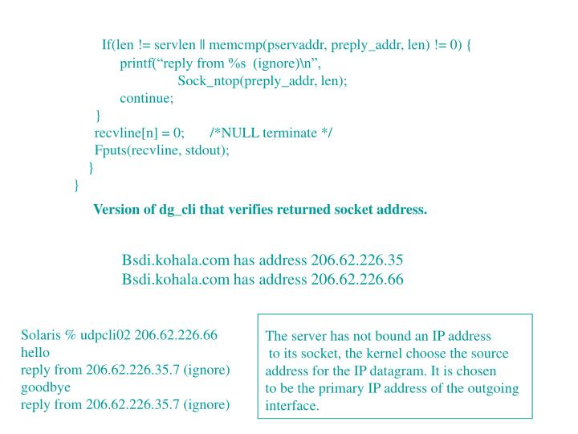
Verifying received responses

Slide 12
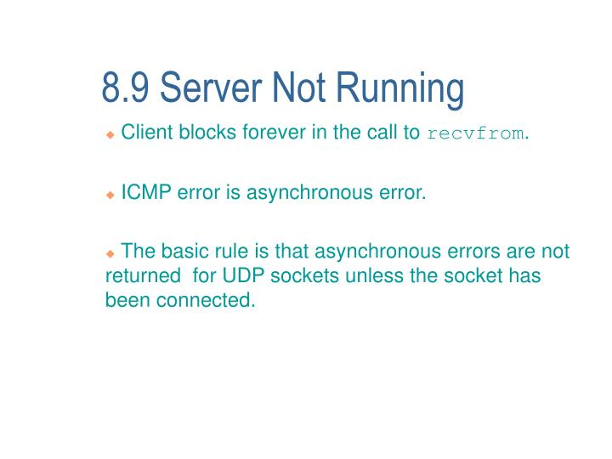
Server Not Running

Slide 13
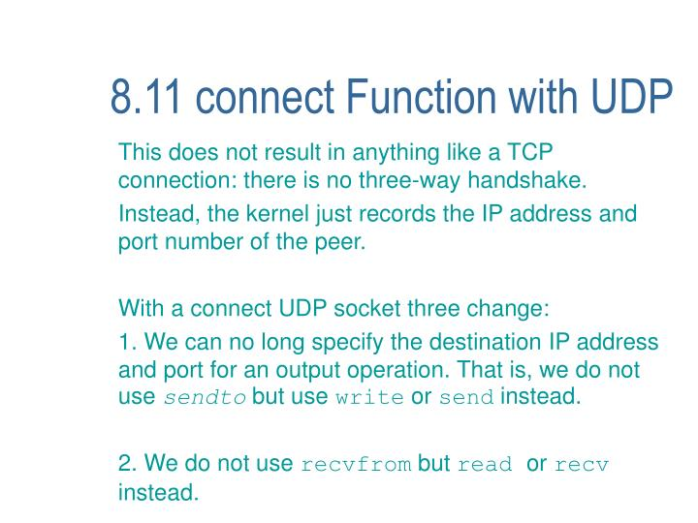
Connect Function with UDP

Slide 14
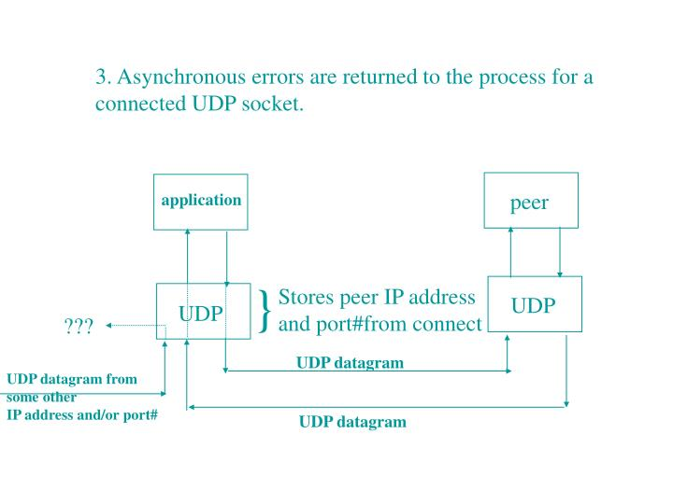
Connect Function with UDP

Slide 15
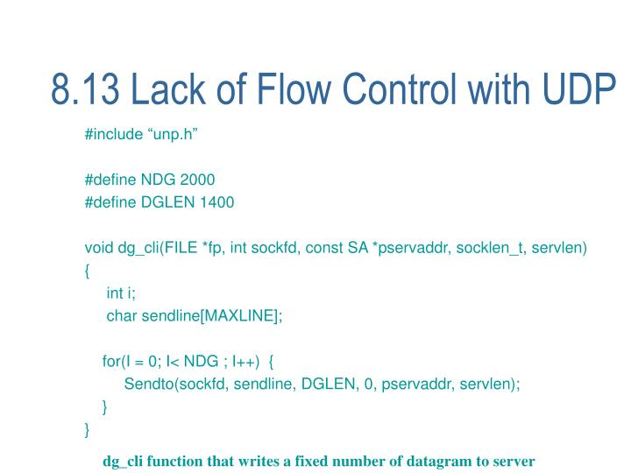
Lack of flow control with UDP

Slide 16
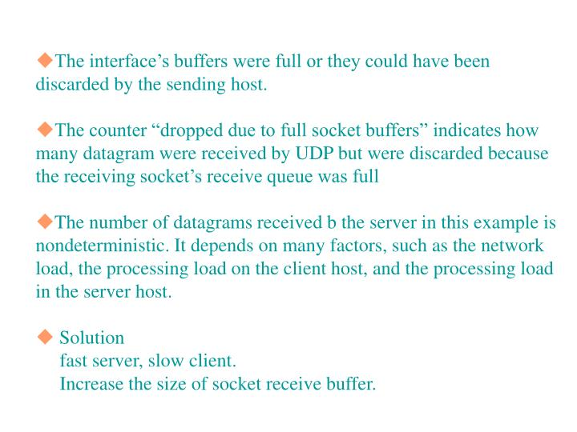
Lack of flow control with UDP

Slide 17
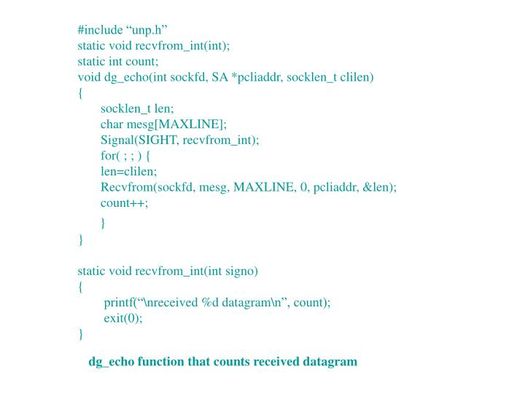
Lack of flow control with UDP

Slide 18
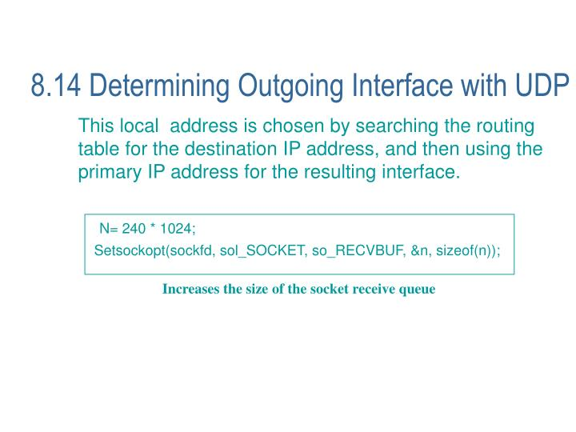
Determining outgoing interface with UDP

Slide 19
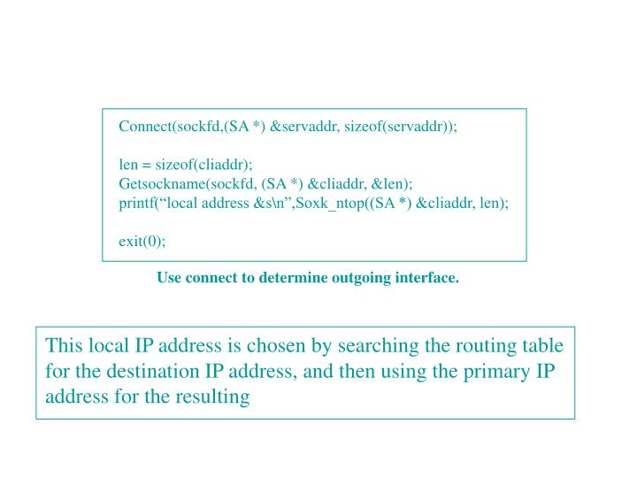
Determining outgoing interface with UDP

Slide 20
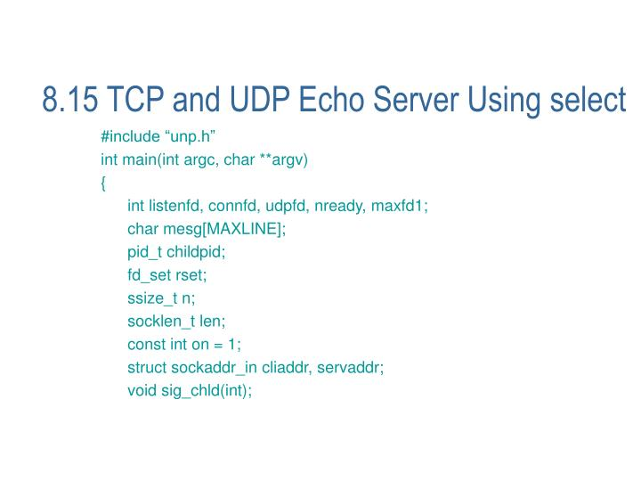
TCP and UDP Echo server with select

Slide 21
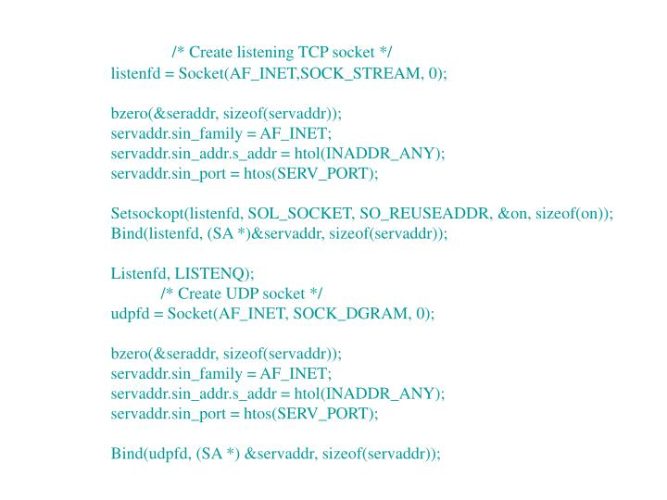
TCP and UDP Echo server with select

Slide 22
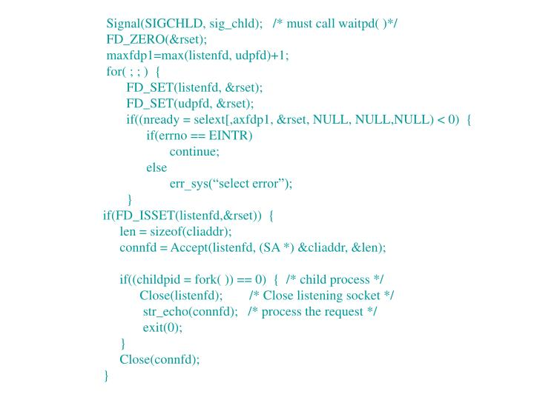
TCP and UDP Echo server with select

Slide 23
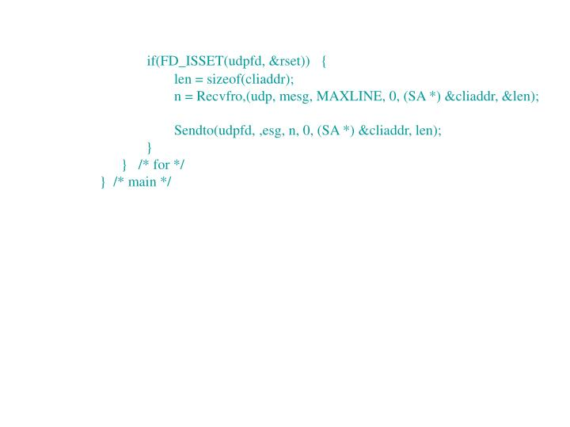

Slide 24
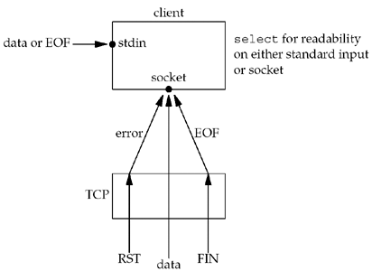

Slide 25
Server
UDP Socket TCP Socket
readfrom ….
SELECT
FD_SET
1
1
0
0
1
0
STDIN

Slide 26
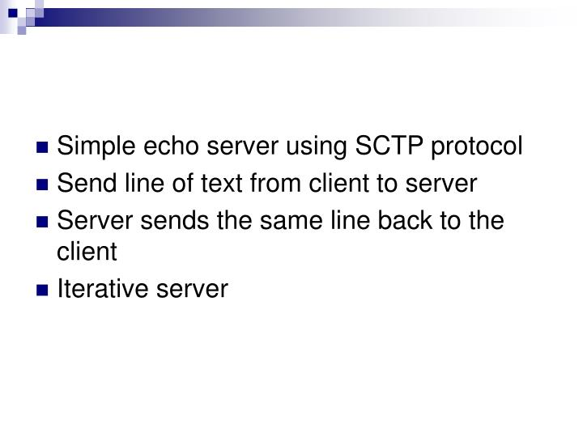

Slide 27
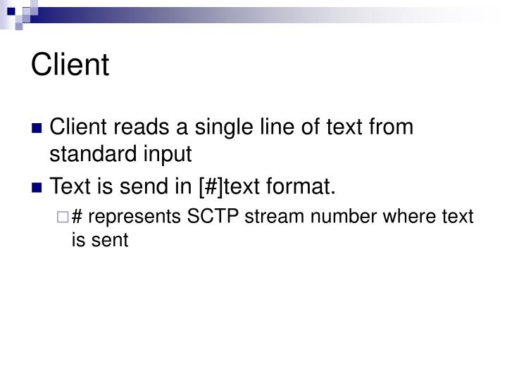

Slide 28
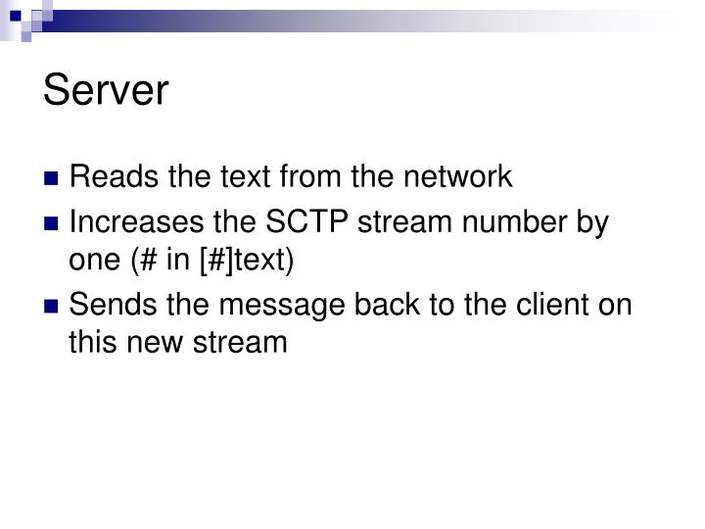

Slide 29
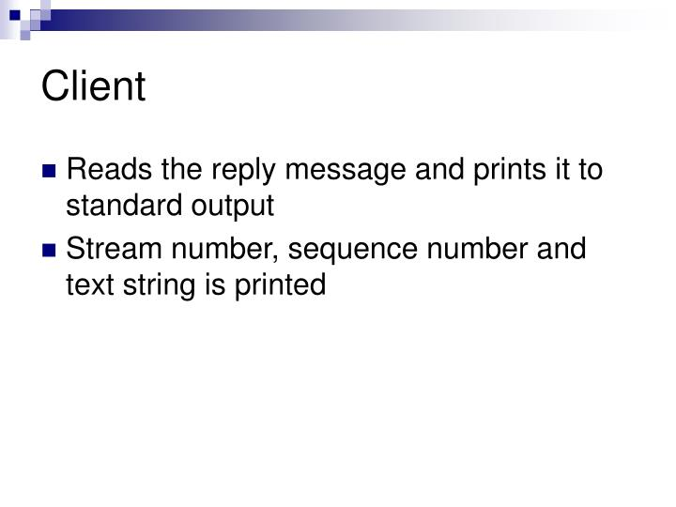

Slide 30
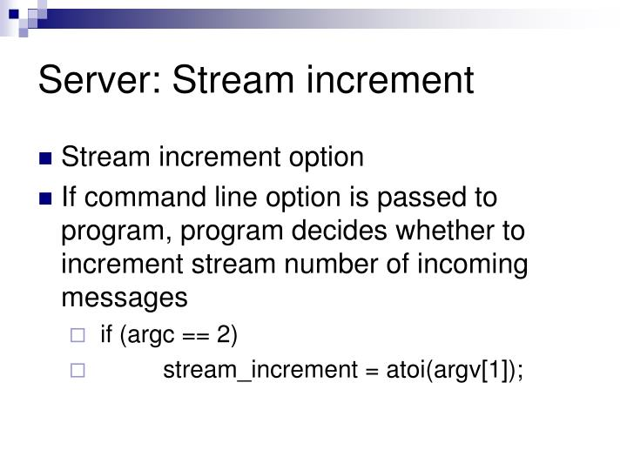

Slide 31
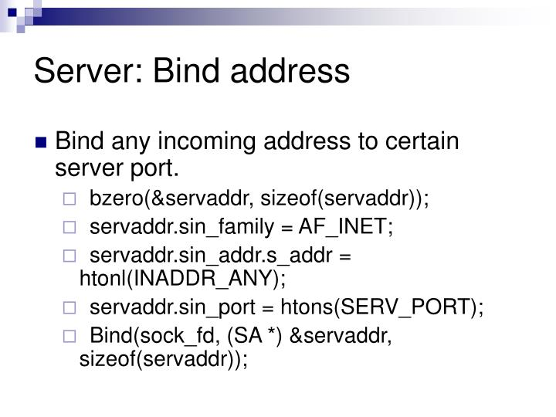

Slide 32
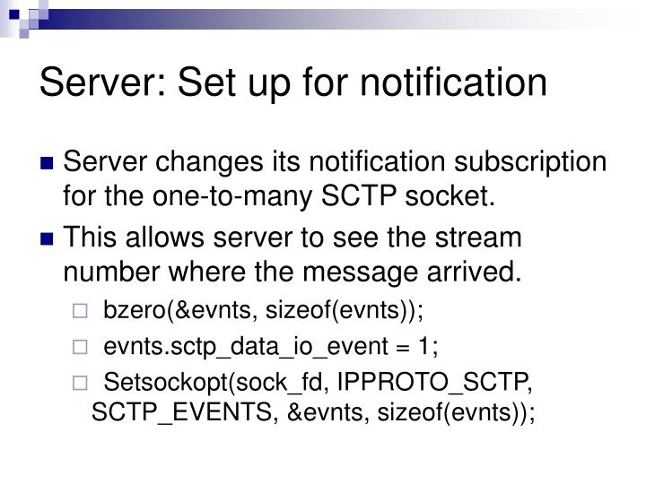

Slide 33
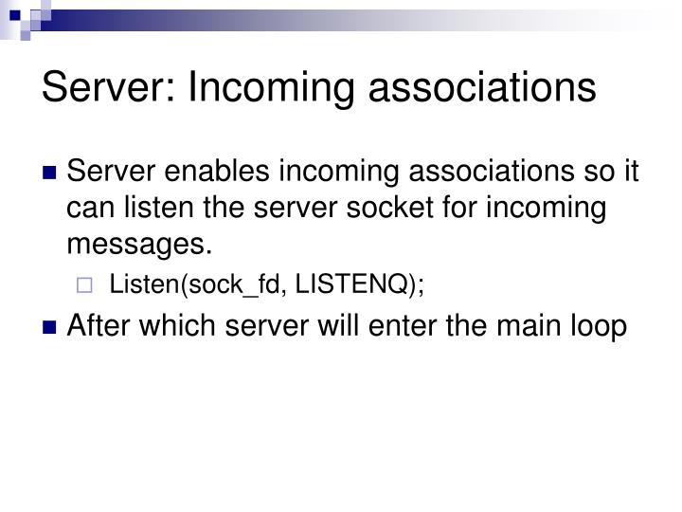

Slide 36
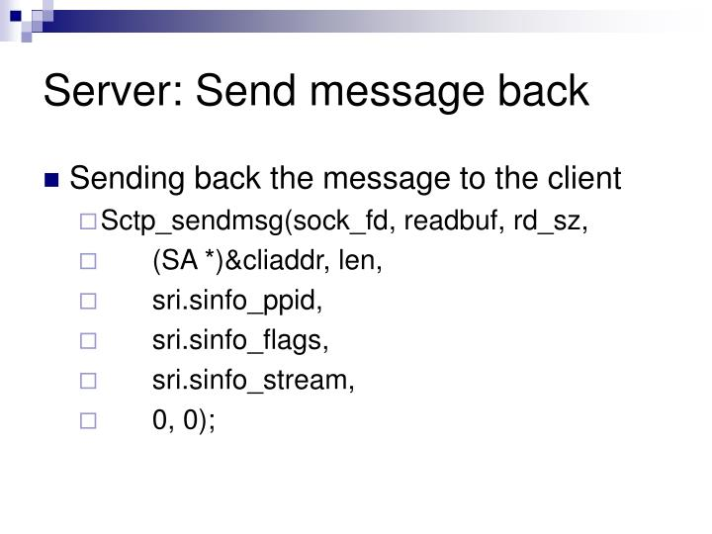

Slide 37
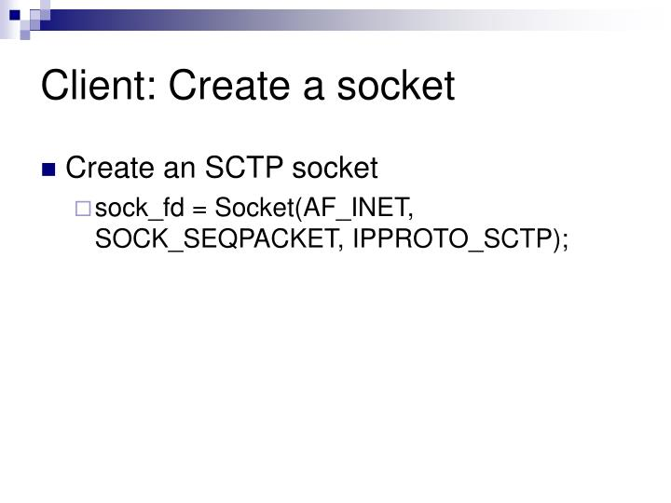

Slide 38
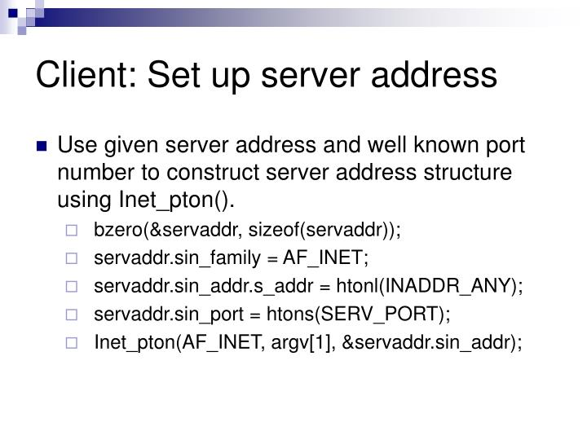

Slide 40
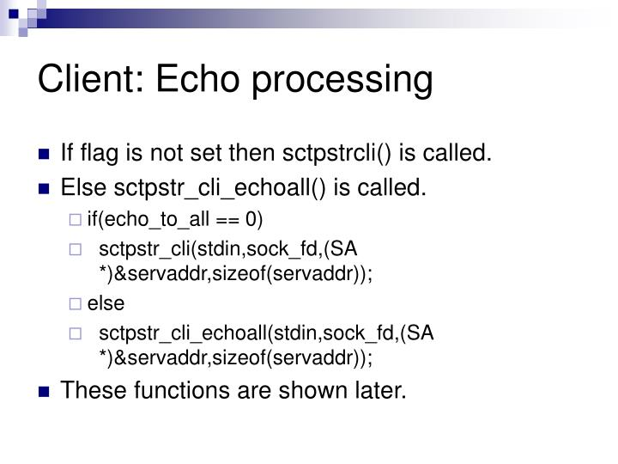

Slide 41
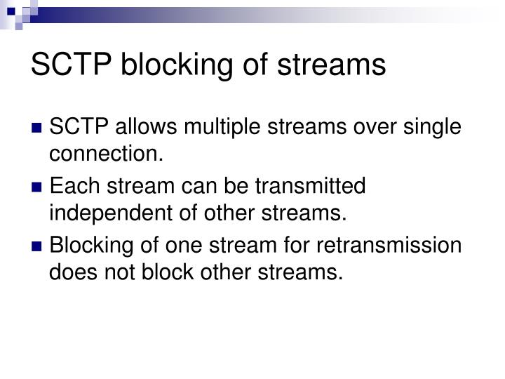

Slide 42
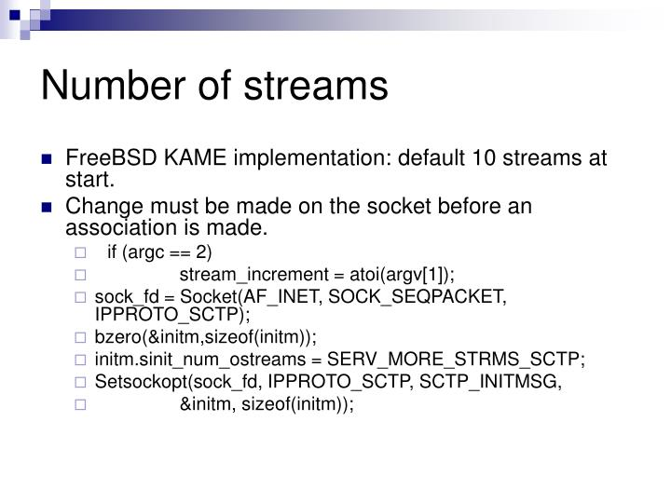

Slide 43
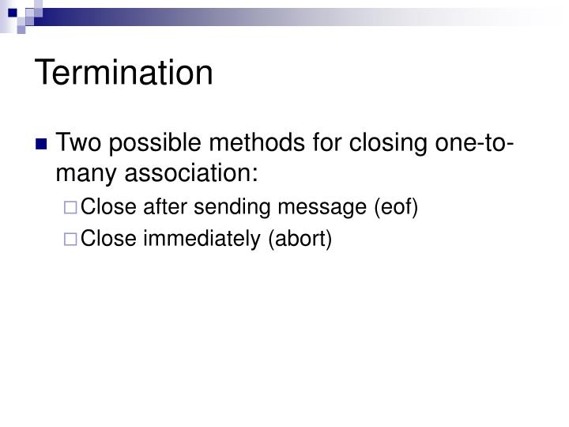

Slide 44
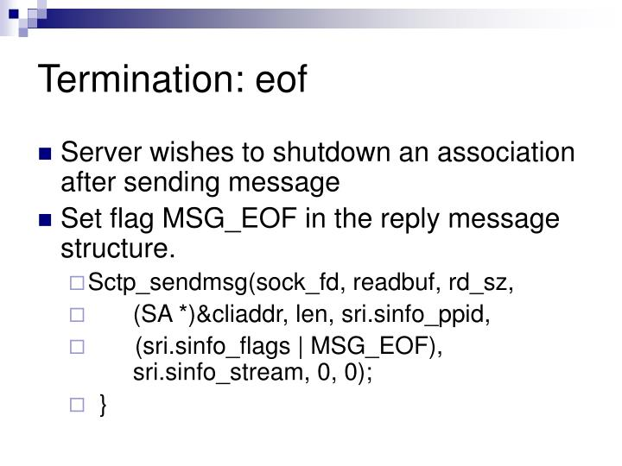

Slide 45
